Slide 1
Software Maintenance and Computer Aided Software Engineering (CASE)
Rajib Mall
CSE Department
IIT KHARAGPUR

Slide 2
Introduction
Software maintenance:
  any modifications to a software product after it has been delivered to the customer.
Software maintenance is an important activity for many organizations.

Slide 3
Introduction
Maintenance is inevitable for almost any kind of product.
Most products need maintenance:
  due to wear and tear caused by use.
Software products do not need maintenance on this count.

Slide 4
Introduction
Many people think
  only bad software products need maintenance.
The opposite is true:
  bad products are thrown away,
  good products are maintained and used for a long time.

Slide 5
Introduction
Software products need maintenance for three reasons:
  corrective
  adaptive
  perfective

Slide 6
Corrective
Corrective maintenance of a software product:
  to correct bugs observed while the system is in use.
  to enhance performance of the product.

Slide 7
Adaptive
A software product needs maintenance (porting) when customers:
  need the product to run on new platforms,
    or, on new operating systems,
  need the product to interface with new hardware or software.

Slide 8
Perfective
Perfective maintenance:
  to support new features required by users.
  to change some functionality
  of the system due to customer demands.

Slide 9
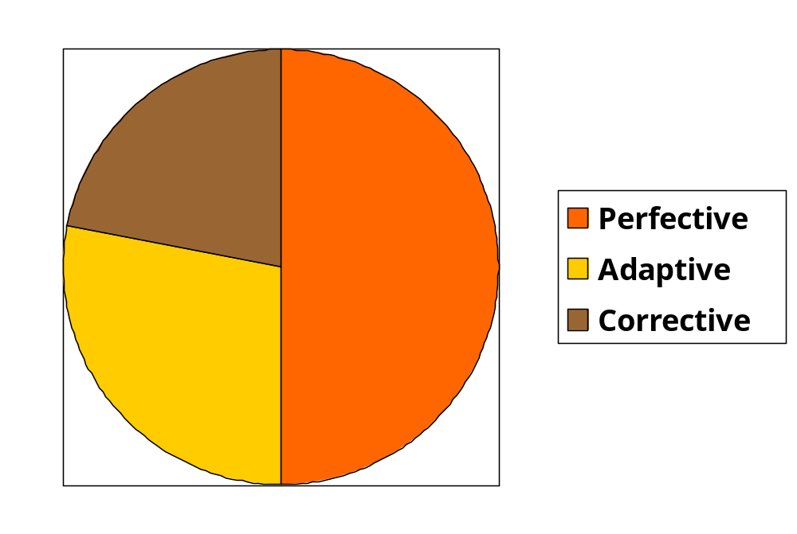
Maintenance Effort Distribution

Slide 10
Causes for maintenance
During development:
  Software not anticipated to last very long (e.g., Y2K problem).
Rate of hardware obsolescence:
  immortality of software products
  maintenance necessary for software performing low-level functions.

Slide 11
Causes for maintenance
Users want existing software to run on new platforms:
  to run in new environments,
  and/or with enhanced features.

Slide 12
Causes for maintenance
Whenever other software it works with change:
  maintenance is needed to cope up with the newer interface.
  For instance, a software product may need maintenance when the operating system changes.

Slide 13
Software evolution
Every software product continues to evolve after its development:
  through maintenance efforts.
Larger software products stay in operation for longer time:
  because of high replacement cost.

Slide 14

Laws of Maintenance
There will always be a lot
of old software needing
maintenance.
Good products are
maintained, bad products
are thrown away.

Slide 15
Laws of Maintenance
Lehman’s first Law:
“Software products must change continuously, or become progressively less useful.”

Slide 16
Laws of Maintenance
Lehman’s Second Law
“When software is maintained, its structure degrades,
  unless active efforts are made to avoid this phenomenon.”

Slide 17
Laws of Maintenance
Lehman’s Third Law:
“Over a program’s life time,
  its rate of development is approximately constant.”

Slide 18
Other Laws of Maintenance
All large programs will undergo significant changes during operation phase of their life cycle,
  regardless of apriori intentions.

Slide 19
Legacy code--- Major maintenance problems
Unstructured code (bad programs)
Maintenance programmers have:
  insufficient knowledge of the system or the application domain.
  Software maintenance has a bad image.
Documentation absent, out of date, or insufficient.

Slide 20
Insufficient knowledge
Maintenance team is usually different from development team.
  even after reading all documents
    it is very difficult to understand why a thing was done in a certain way.
  Also there is a limit to the rate at which a person can study documents
    and extract relevant information

Slide 21
Bad image of maintenance?
Maintainers are skilled not only in writing code:
  proficient in understanding others’ code
  detecting problems, modifying the design, code, and documentation
  working with end-users

Slide 22
Maintenance Nightmares
Use of gotos
Lengthy procedures
Poor and inconsistent naming
Poor module structure
Weak cohesion and high coupling
Deeply nested conditional statements
Functions having side effects

Slide 23
How to do better maintenance?
Program understanding
Reverse engineering
Design recovery
Reengineering
Maintenance process models

Slide 24
Maintenance activities
Two types of activities:
  Productive activities:
    modification of analysis, design, coding, etc.
  Non-productive activities:
    understanding system design, code, etc.

Slide 25
Software Reverse Engineering
By analyzing a program code, recover from it:
  the design and the requirements specification.

Slide 26
Software Reverse Engineering
Reverse engineering is an important maintenance technique:
  several existing software products are unstructured,
  lack proper documentation,
  were not developed using software engineering principles.

Slide 27
Software Reverse Engineering
First carry out cosmetic changes to the code to improve:
  readability,
  structure,
  understandability.

Slide 28
Cosmetic changes
Reformat Program
Assign Meaningful
Names
Simplify Conditions
Simplify Processing
Replace GOTOs

Slide 29
Cosmetic Changes
Reformat the program:
  use any pretty printer program
  layout the program neatly.
Give more meaningful names to:
  Variables, data structures, and functions.

Slide 30
Cosmetic Changes
Replace complex and nested conditional expressions:
  simpler conditional statements
  whenever appropriate use case statements.

Slide 31
Software Reverse Engineering
In order to extract the design:
  fully understand the code.
Automatic tools can be used to help derive:
  data flow and control flow diagrams from the code.

Slide 32
Software Reverse Engineering
Extract structure chart:
  module invocation sequence and data interchange among modules.
Extract requirements specification:
  after thoroughly understanding the code.
  design has been extracted.

Slide 33
Software Maintenance Process Models
Maintenance activities are not unique:
  depend on the extent of modifications required,
  also, depend on condition of the product:
    how structured it is,
    how well documented it is, etc.

Slide 34
Software Maintenance Process Model - 1
When the required changes are small and simple:
  the code can be directly modified
  changes reflected in all relevant documents.
  more elaborate activities are required when required changes are not trivial.

Slide 35
Software Maintenance Process Model - 1
Gather Change Requirements
Analyze Change Requirements
Devise Code Change Strategies
Apply Code Change Strategies
Update Documents
Integrate and Test

Slide 36
Software Maintenance Process Model 1
Start by gathering change requirements.
Analyze change requirements
  formulate strategies for code change.

Slide 37
Software Maintenance Process Model 1
Formulating strategies for code change:
  presence of few members of the original development team
    helps in reducing cycle time,
    especially for unstructured and inadequately documented code.

Slide 38
Software Maintenance Process Model 1
Availability of a working old system at the maintenance site:
  greatly helps the maintenance team
  provides a good insight into the working of the old system
  can compare the working of the modified system with the old system.

Slide 39
Software Maintenance Process Model 1
Debugging the system under maintenance becomes easier:
  program traces of both the systems can be compared to localize bugs.

Slide 40
Software Maintenance Process Model -2
For complex maintenance projects, software reengineering needed:
  a reverse engineering cycle followed by a forward engineering cycle.
  with as much reuse as possible from existing code and other documents.

Slide 41
Maintenance Process Model 2
Preferable when:
  amount of rework is significant
  software has poor structure.
Can be represented by a reverse engineering cycle:
  followed by a forward engineering cycle.

Slide 42
Software reengineering
Many aging software products belong to this category.
During the reverse engineering,
  the old code is analyzed (abstracted) to extract the module specifications.

Slide 43
Software reengineering
The module specifications are analyzed
  to produce the design.
The design is analyzed (abstracted)
  to produce the original requirements specification.
The change requests are then applied to the requirements specification:
  arrive at the new requirements specification.

Slide 44
Software reengineering
Forward engineering is carried out to produce the new code.
During design, module specification, and coding:
  substantial reuse is made from the reverse engineered products.

Slide 45
Process model for Software reengineering
Change Requirements
Requirements Specification
New Requirements Specification
Design
Design
Code
Code

Slide 46
Software reengineering
Advantages of reengineering:
  produces better design than the original product,
  produces required documents,
  often results in higher efficiency.

Slide 47
Software reengineering
Efficiency improvements are brought about by better design.
  However, this approach is more costly than the first approach.
An empirical study indicates:
  process 1 is preferable when amount of rework is no more than 15%.

Slide 48
Software reengineering
Reengineering is preferable when:
  amount of rework is high,
  product exhibits high failure rate.
  product difficult to understand.

